Slide 1

Mobile Device Usage Patterns and User Behaviour Classification

Slide 2

Dataset
This dataset analyzes mobile device usage patterns and classifies user behavior into five categories, from light to extreme usage.
It includes 700 samples with metrics such as app usage time, screen-on time, battery drain, and data consumption. Key features include user ID, device model, operating system, number of apps installed, age, gender, and user behavior class.
Data Link: https://www.kaggle.com/datasets/valakhorasani/mobile-device-usage-and-user-behavior-dataset

Slide 3
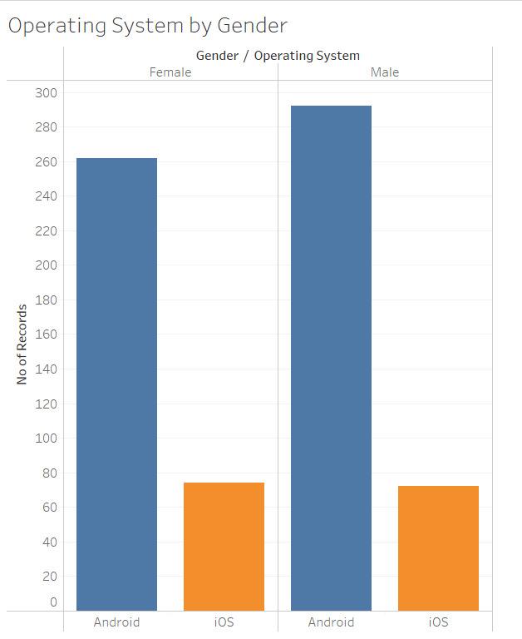
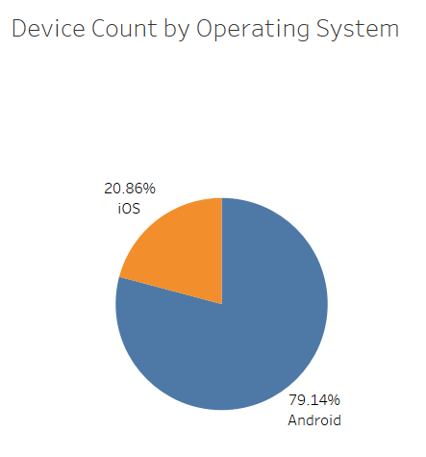
Operating System
The bar graph highlights the distribution of operating systems (Android vs. iOS) by gender.
Android dominates across both genders, with approximately 290 male and 260 female users.
iOS usage is significantly lower, with around 75 users each for both males and females.
Pie Charts Shows that most devices in the dataset run on Android, with a smaller share on iOS.

Slide 4

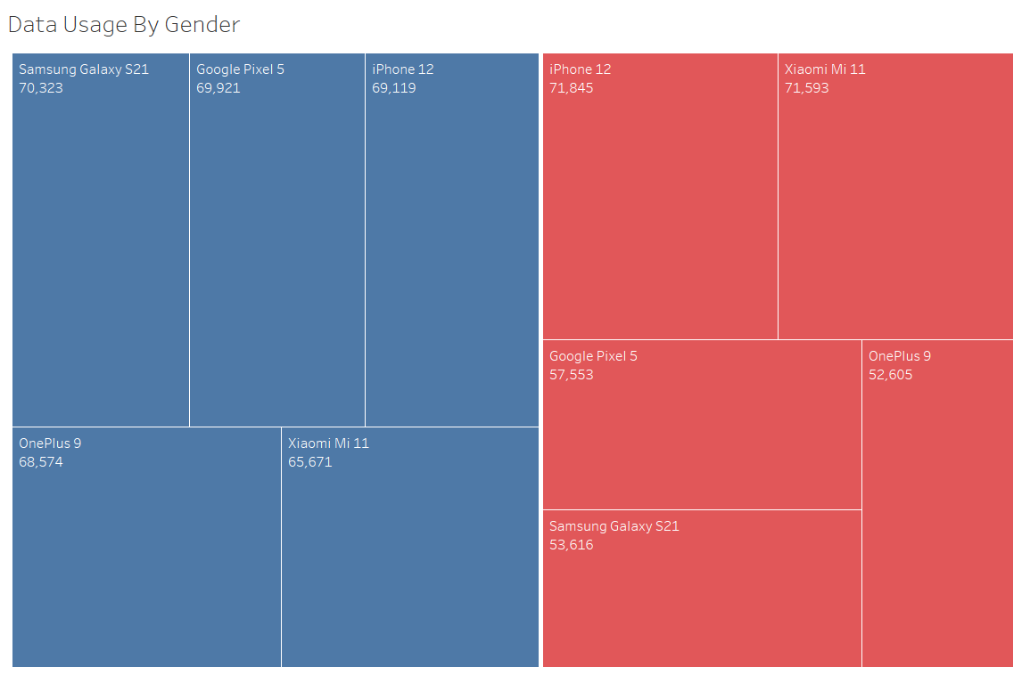
Data Usage by Device Model
The Tree Map reveals that female users tend to have higher data consumption on Xiaomi Mi 11 and iPhone 12, while male users show more consistent usage across different devices, with Samsung Galaxy S21 being their highest data-consuming device.

Slide 5
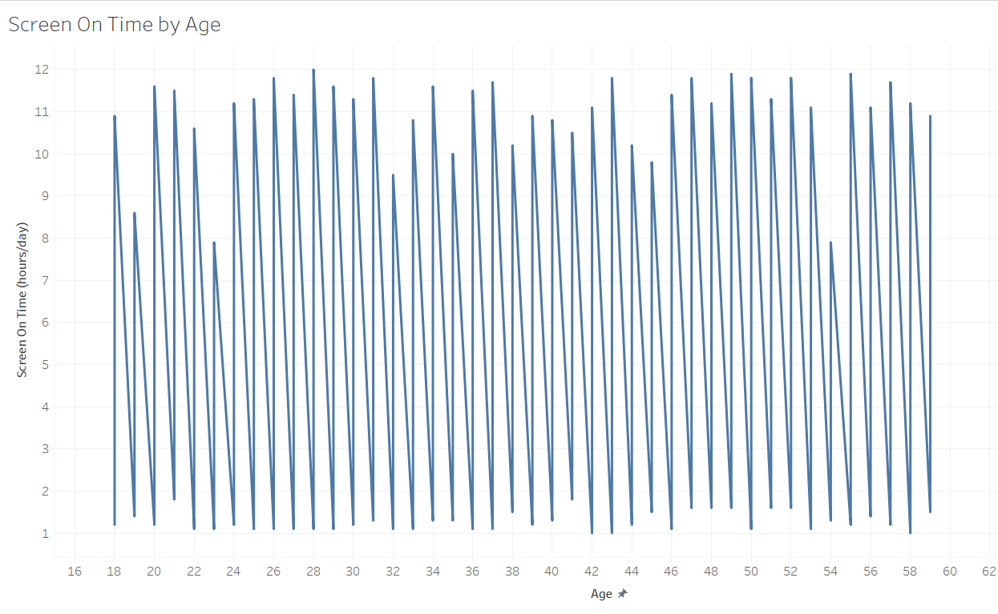
Screen Time by Age
The maximum screen time peaks at around 12 hours per day
The minimum screen time consistently drops to about 1-2 hours per day
The line graph shows regular fluctuations across all age groups
There's no clear trend of increase or decrease with age
The oscillation pattern remains consistent from younger to older ages

Slide 6
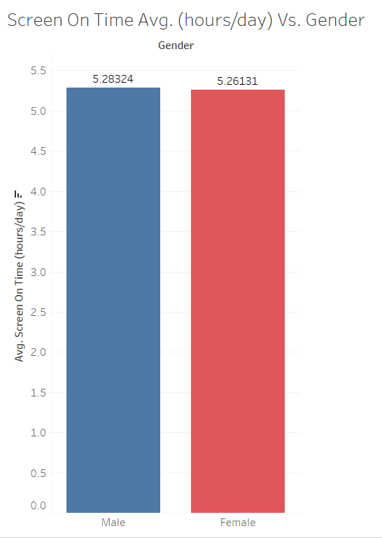
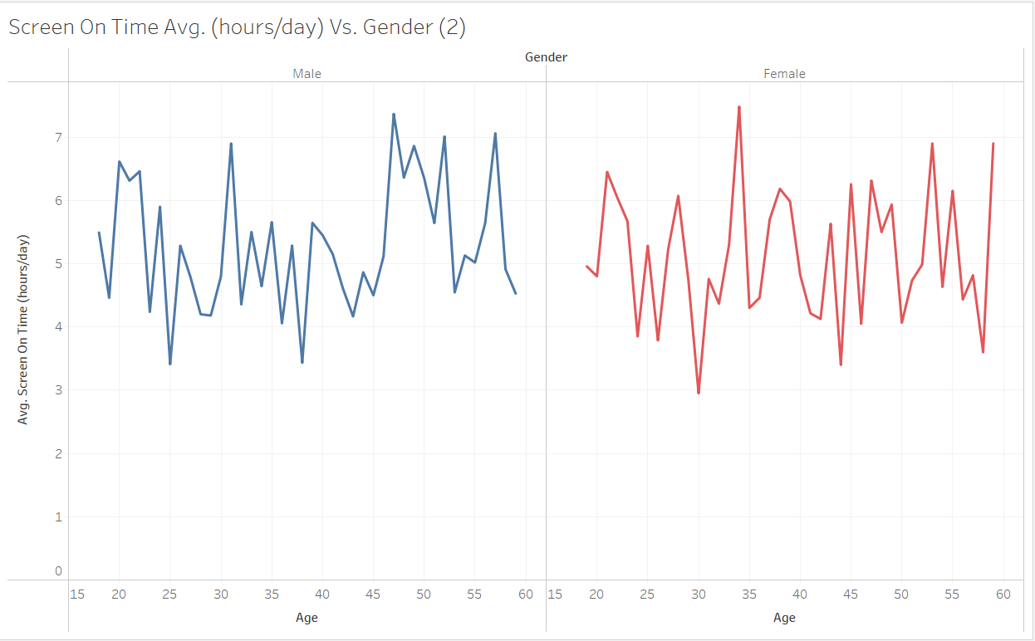
Screen Time by Gender

Slide 7
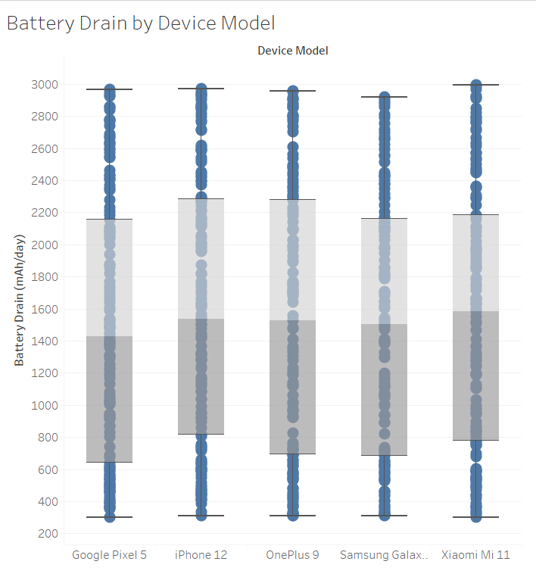
Battery Drain by Device Model
All devices maintain drain values between 2155 - 2282 mAh/day at their upper ranges.
Xiaomi Mi 11 shows the highest average daily drain.
The difference between highest and lowest drain is approximately Avg. 156 mAh/day.
Google Pixel 5 and Samsung Galaxy S21 show more consistent battery performance. So, we can recommend this phones for buying.

Slide 8
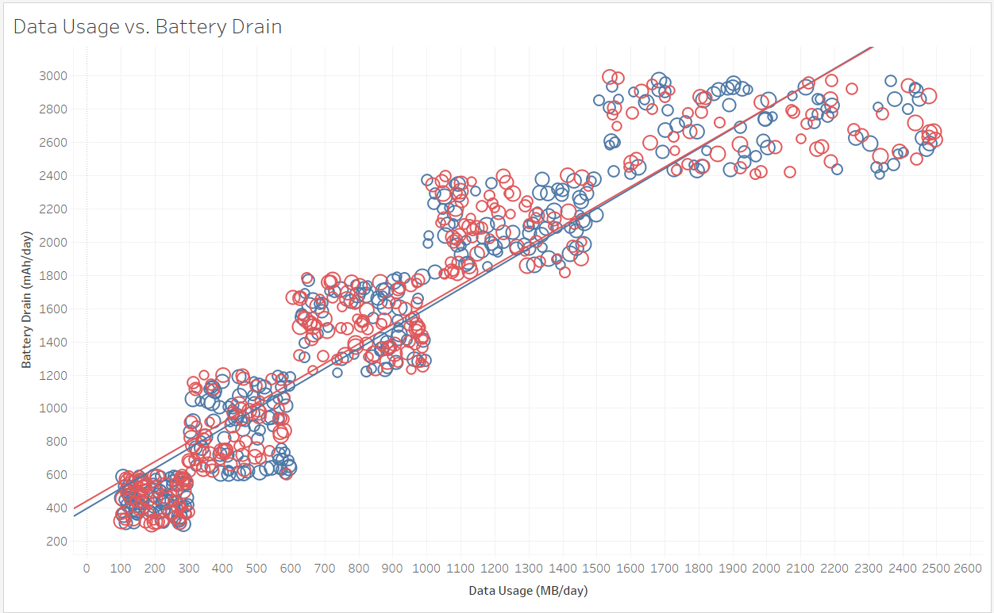
Data Usage vs. Battery Drain

Slide 9
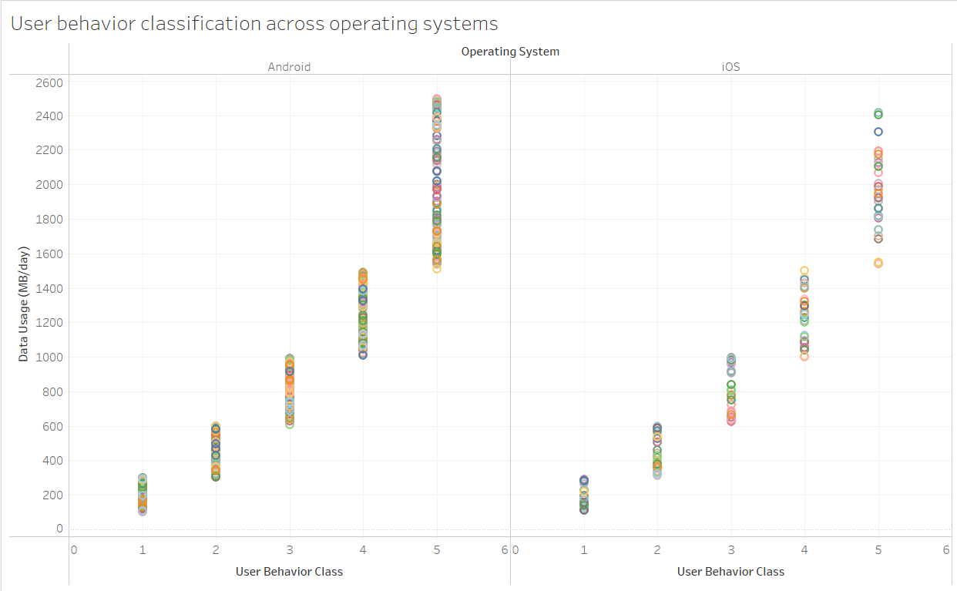
User Behaviour

Slide 10
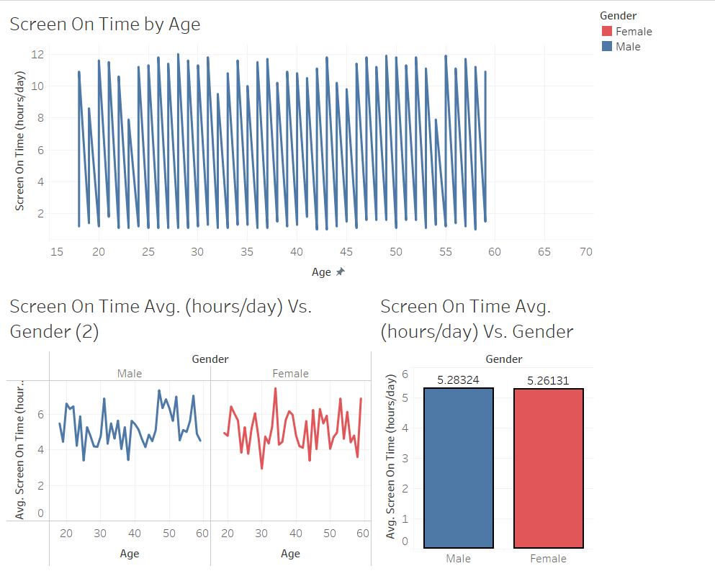
Screen Time Analytics - Dashboard

Slide 11
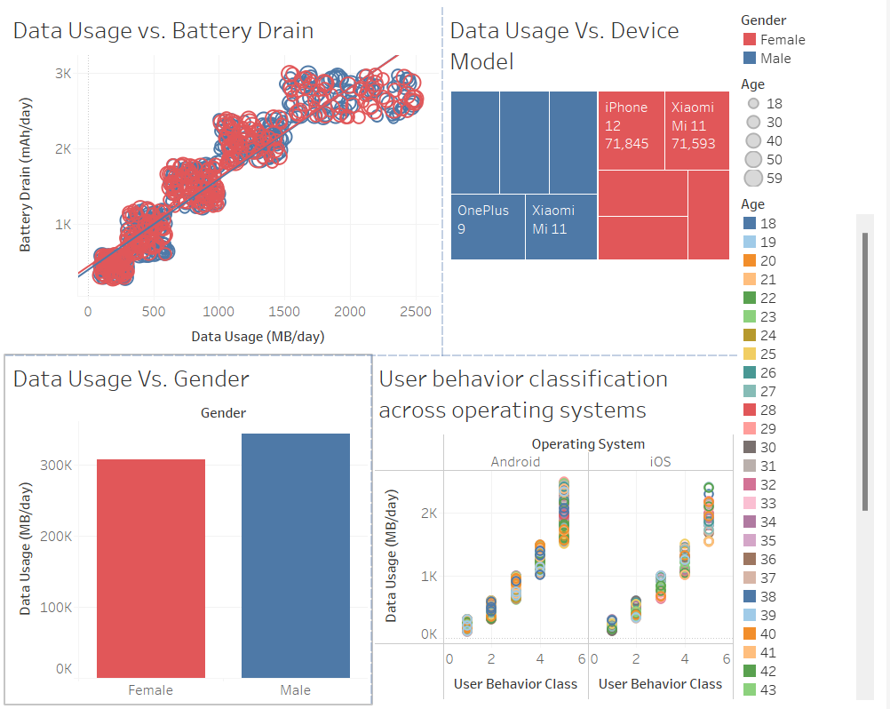
Data Usage Analytics - Dashboard

Slide 12
THANK YOU

